Slide 1

Adapting MINUTE-ChIP for
High-Throughput MBD-seq
Cross-Platform Validation Against Illumina MethylationEPIC 850k
Klaudia Orfin
Uppsala University | Precision Medicine Project, 15 credits
Supervisor: Shumaila Sayyab
Maria Lerm’s Group (BKV) Linköping University.
Notes:
Hello everyone,
Today I would like to present to you my Research Project in Precision Medicine that I got to do at Maria’s group (once again), this time under a watchful eye of Shumaila. The project is also a collaboration between the research group and Epigenica who kindly guided us and supported whenever we needed help. My objective was to use the MINUTE pipeline, normally used for histone methylation, and adapt it to DNA methylation. Now because we had access to the same PBMC samples, I could compare and see what kind of results we get from the Illumina 850k Array vs. Epigenica’s pipeline.

Slide 2
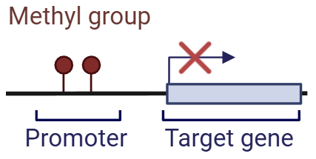
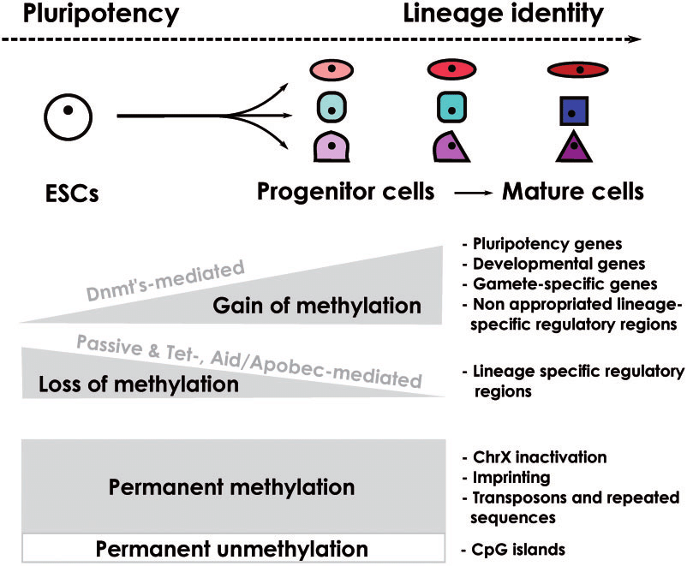
Epigenetics
DNA Methylation (DNAme): Methyl group on C5 cytosine that regulates gene expression without changing the sequence.
Determinant of cell fate and differentiation.
Critical response to infection, cancer, and stimuli.
Reversible nature enables novel therapies.
Epigenetics is central to early disease detection and personalized prognosis.
Source: ResearchGate
Notes:
Let me briefly introduce the concept of epigenetics even though I’m sure everyone is an expert on it. Epigenetics describes how genetic code is regulated. For the purpose of this project we only focus on DNA methylation. It can give information about one’s lifestyle (active vs. sedimentary), smoking, predict age, past diseases, cancer, etc. DNA methylation is the addition of methyl group on carbon 5 in cytosine and is most commonly followed by guanine - CpG. This regulates gene expression without changing the DNA sequence. In the entire genome we have regions rich and poor in CpG sites (CpG islands), and these regions are typically gene regulatory regions such as gene promoters. (Picture) Methyl groups attached -> gene silencing, and vice versa. This regulation has a vital function in living organisms, because it determines the cell fate and differentiation. Looking at the right picture we can see that the more methylation we gain by going to the right, the more differentiated the cell is. It looses pluripotency genes and expresses only ones that the cell needs to fullfill its functions. This process is tightly regulated in developmental biology. If we focus at the bottom part, we can see that certain regions in the genome are either permanently methylated or unmethylated. That information is crucial to understand DNA methylation in context of diseases and infections. For instance in cancer, epigenetic changes are one of the main hallmarks - we see either silencing of tumor suppressor genes like p53 (repairs DNA damage) or activation of oncogenes by unmethylating their promoters. The ‘good’ thing about it is that methylation is a reversible process, so it can be utilized in developing novel therapies.

Slide 3






Challenges in Methylation Profiling
High Cost
Harsh Treatment
Batch Effects
Whole Genome Bisulphite Sequencing (WGBS) remains expensive for large clinical cohorts (~250$ / sample).
Extreme pH and temperatures in bisulphite conversion can damage rare cell types or liquid biopsies (cfDNA).
Significant technical variability requires mathematical corrections that may obscure true biological signals.
Notes:
Nowadays, the gold standard lies in bisulfite conversion methods, which remain quite expensive, damage the DNA with harsh chemicals and temperature and are not friendly to low DNA inputs from rare cell types or liquid biopsies (which have been recently of very high interest due to the high specificity, ease and short processing times). Additionally, we have to deal with batch corrections and technical variability, which are not welcome in experiments that require high repetitions and multiple sample testing. How can we screen for DNA methylation without using bisulphite conversion?

Slide 4
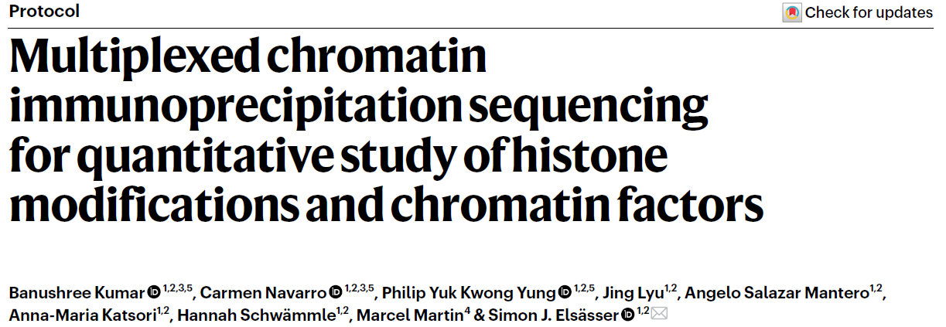
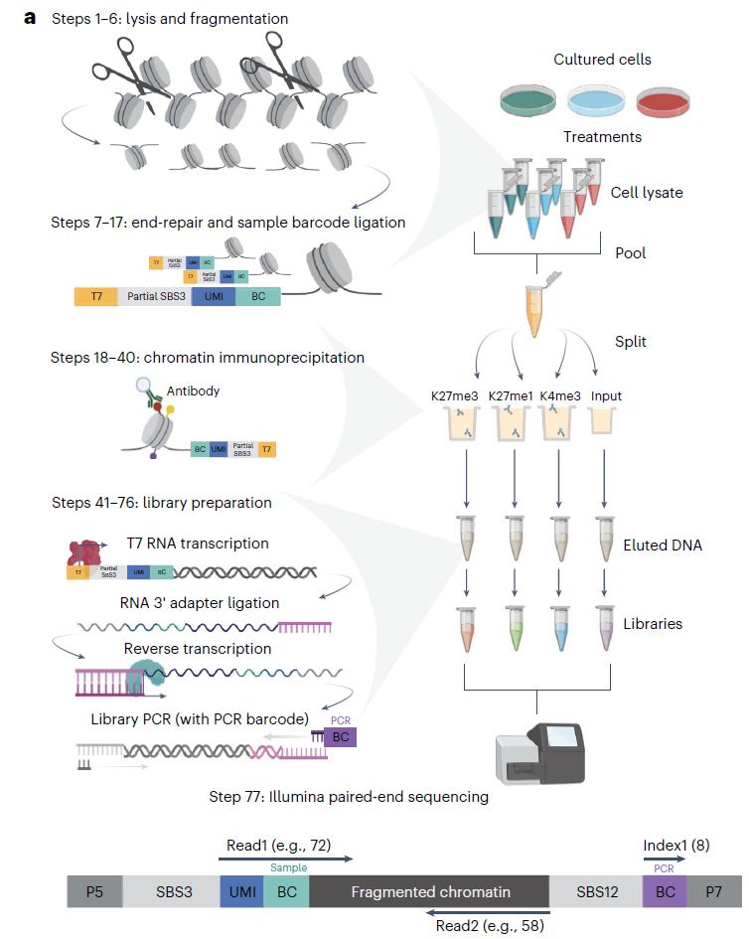
Quantitative Multiplexing (MINUTE)
Physical Multiplexing Strategy
Adapting the MINUTE-ChIP pipeline (originally for histone marks) to standardized DNA methylation analysis.
Efficiency: Up to 12 samples analyzed simultaneously.
Precision: Reduces batch effects at the source through physical pooling.
Scalable: Reproducible workflow for clinical discovery.
Notes:
We can utilize Next Generation Sequencing Technologies. Epigenica has patented a multiplexing protocol, which was published last year in Nature and was primarily used for analysing histone methylation. Why is it so attractive? It uses a barcoding method, where after the standard lysis and DNA fragmentation common to sequencing methods, we mix the fragments with unique barcodes which ligate to the DNA. We pool all the samples together into one tube. Then we use many different antibodies (in case of histones), depending on what type of histone modification we are interested in and we sequence the reads e.g. on an Illumina instrument. Afterwards the samples are demultiplexed through the MINUTE pipeline which means that we can identify separate samples in the pool thanks to the unique barcodes they had been labelled with before. This makes it a very attractive method for clinical discovery.

Slide 5
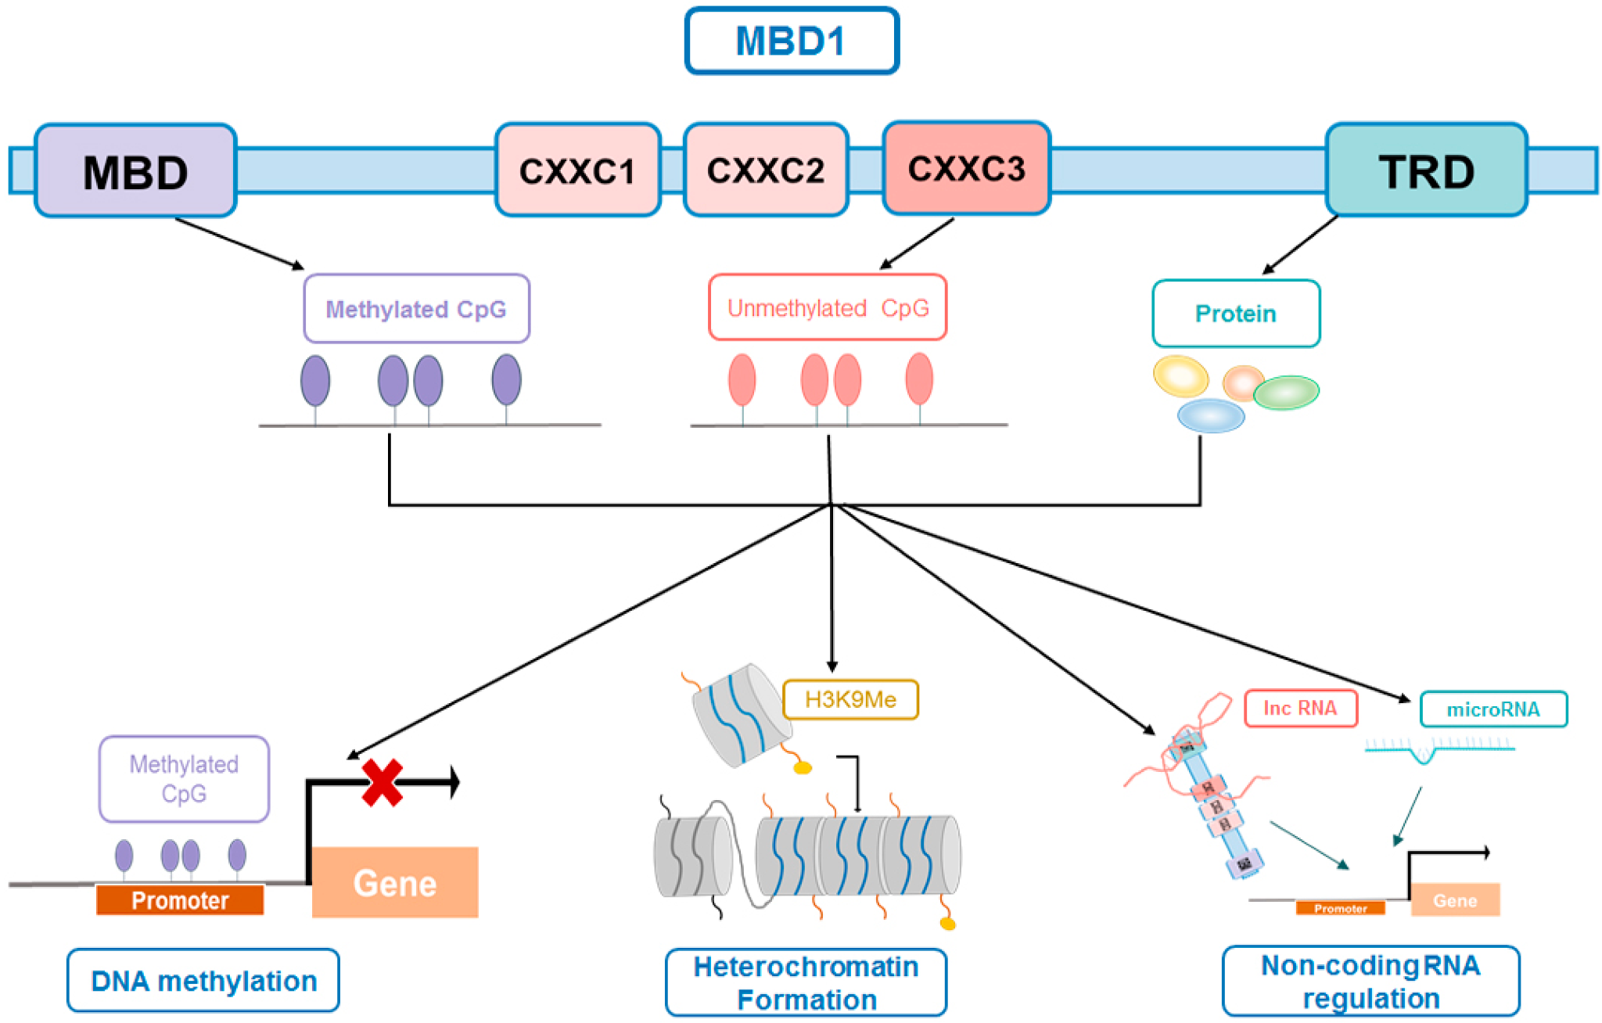
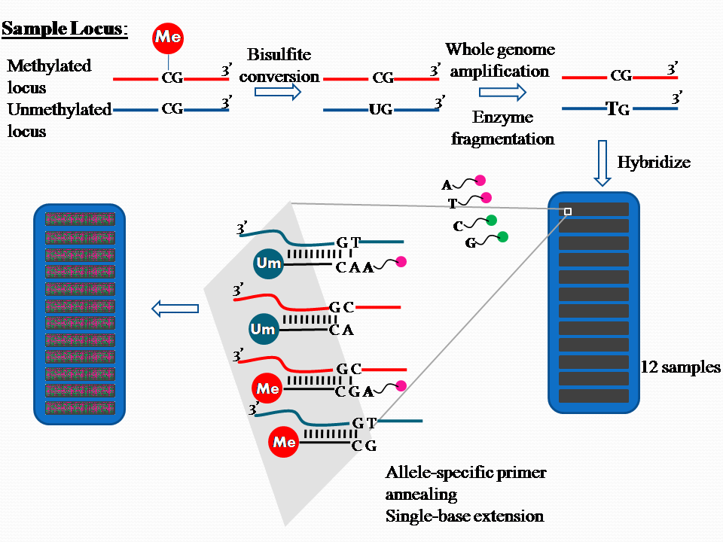
Project Objectives & Scope
Re-engineer the MINUTE pipeline for Methyl-CpG-Binding Domain (MBD) capture data.
Compare performance against the "Gold Standard" Illumina MethylationEPIC 850k array.
Validate the biology (Methylated vs. Unmethylated gene lists).
Source: https://en.wikipedia.org/wiki/Illumina_Methylation_Assay
Notes:
My goal of the project was to see whether we can use Epigenica’s MINUTE pipeline and adapt it for analysis DNA methylation. I cannot take the credit for the labwork because it was Zoe who successfully followed the protocol and prepared the samples, so thank you so much for that Zoe!
Here, instead of using antibodies (like for histones), we use a protein that naturally occurs in the cells - Methyl-CpG-Binding Domain to capture CpG rich regions. As a control we use an CXXC protein that binds unmethylated CpG. It is crucial to point out now that this is a completely different method to study DNA methylation. With MINUTE we capture regions rich in CpGs, so it’s an enrichment methods - the more reads the more methylation we detect. With the 850k array, we hybridize 850,000 predesigned probes to specific regions and we detect them by measuring the fluorescent signals (red vs. green).

Slide 6
Experimental Design: M1-M4
Condition | Target | Function
M1 (Input) | Total DNA (no selection) | Baseline control; read spread across entire genome.
M2 (In-house) | Methylated CpG | Epigenica’s in-house MBD protein for validation.
M3 (CXXC) | Unmethylated CpG | Mirror-image validation of active promoter status.
M4 (Commercial) | Methylated CpG | Standard commercial MBD protein.
Notes:
Samples were labelled in the following way….

Slide 7
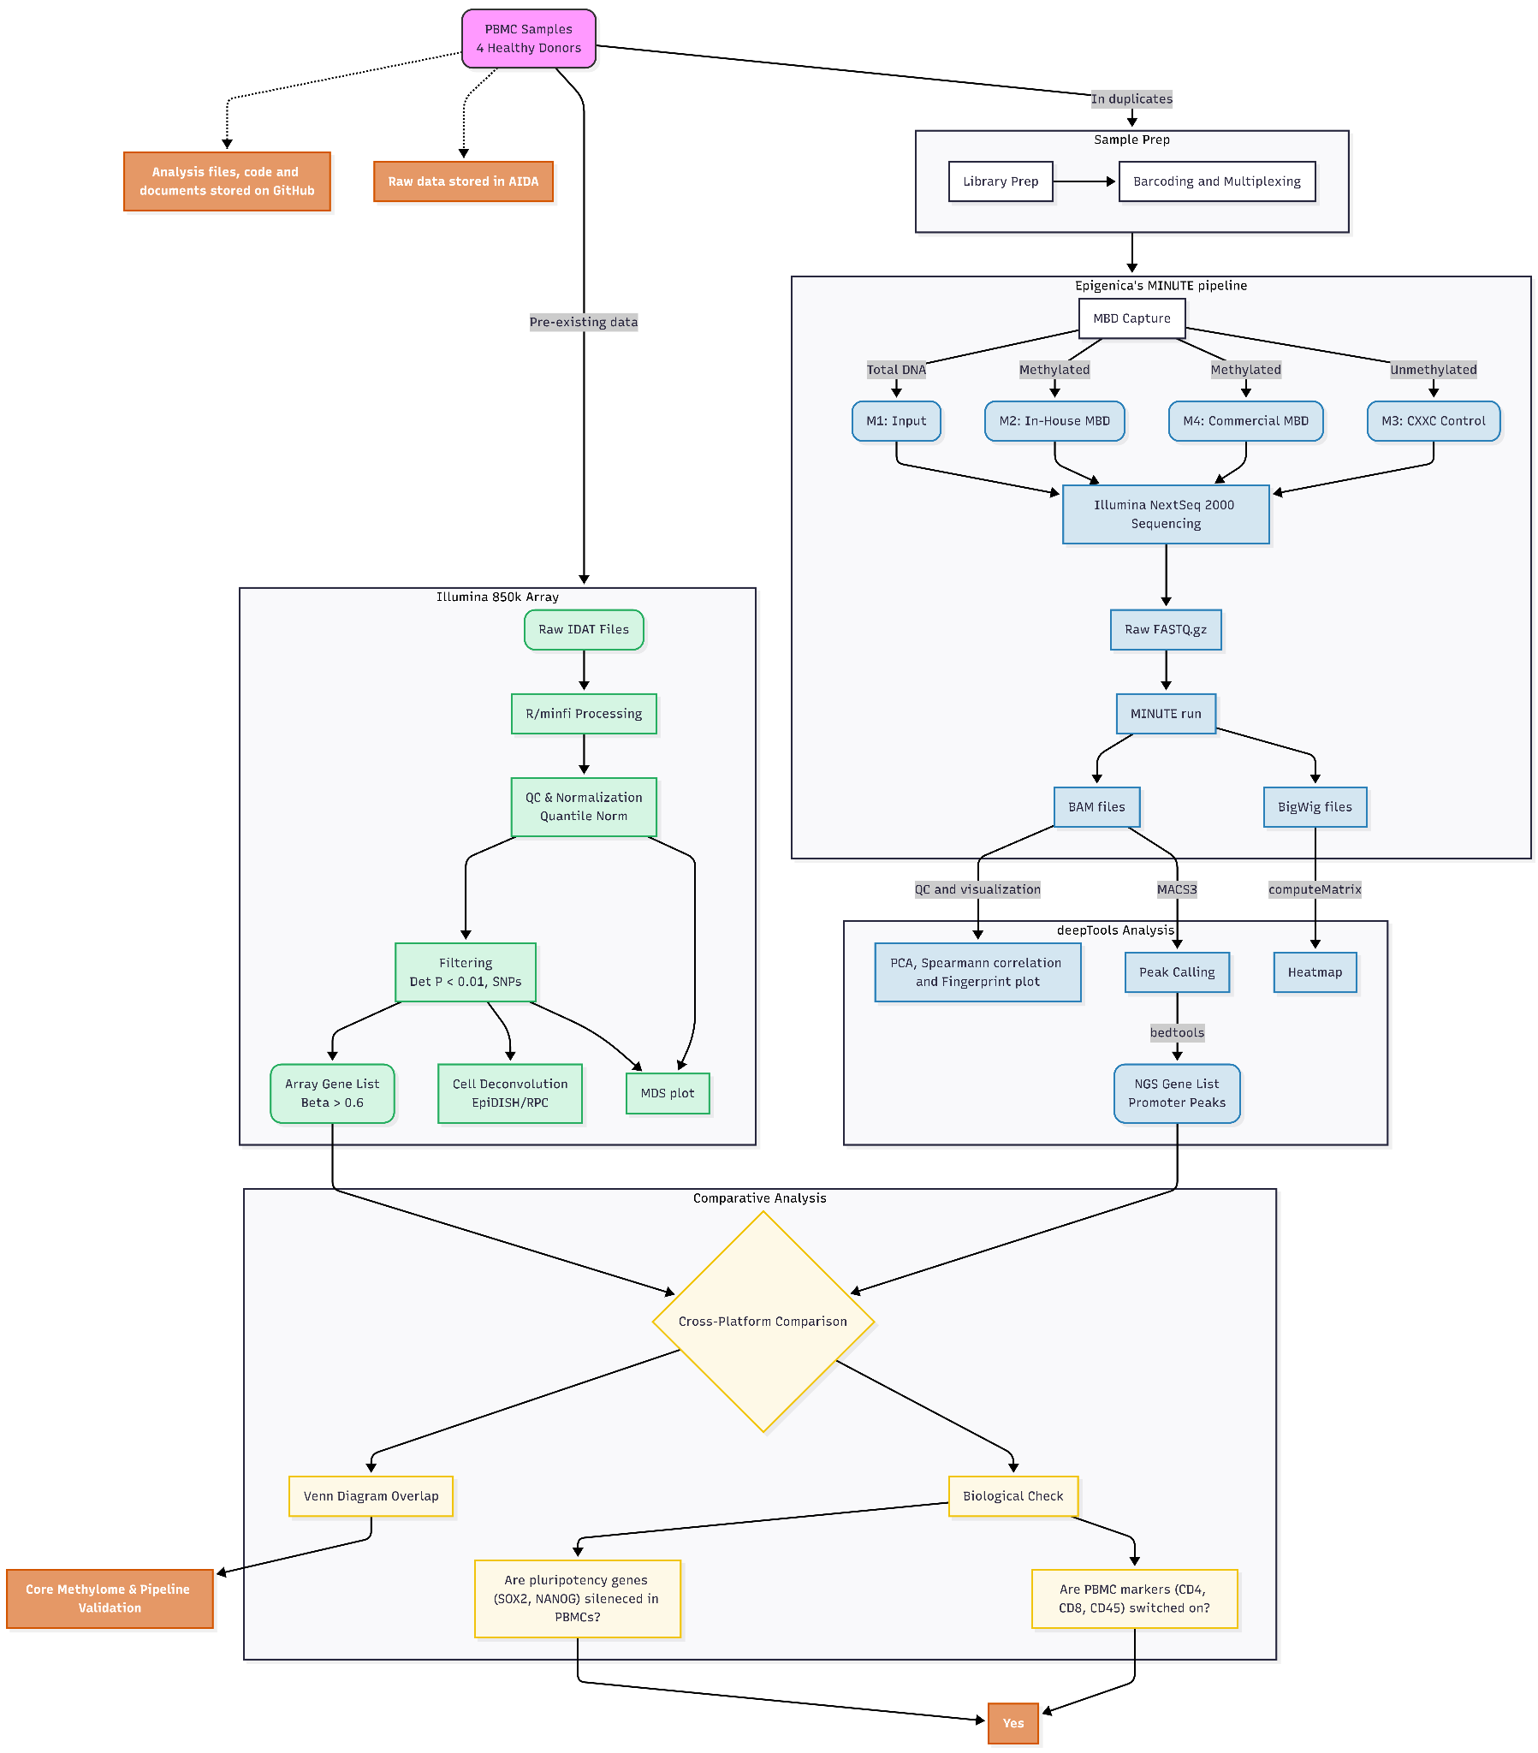
Workflow

Slide 8
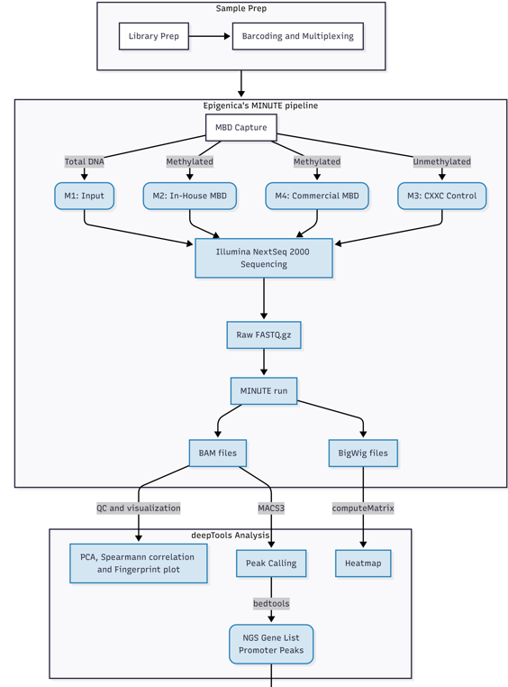
The Bioinformatics: MINUTE init? and deepTools
Alignment: Bowtie2 mapping to hg19 with ENCODE blacklist filtering.
Analysis: deepTools for downstream analysis and visualization.
Peak Calling: MACS3 regional enrichment detection.
Annotation: Bedtools intersection with GENCODE map.
Notes:
Step-by-step go through the workflow
BAM files store raw, detailed read alignments (sequences, mapping quality, splice junctions, variants) for primary analysis. They are binary files (not human readable) with large size.
BigWig files store compressed, indexed genome-wide coverage/signal (read depth) for efficient visualization and comparison in browsers like UCSC. This is sensitive data that in our case is stored safely on the AIDA Data Science Platform in Linköping.

Slide 9
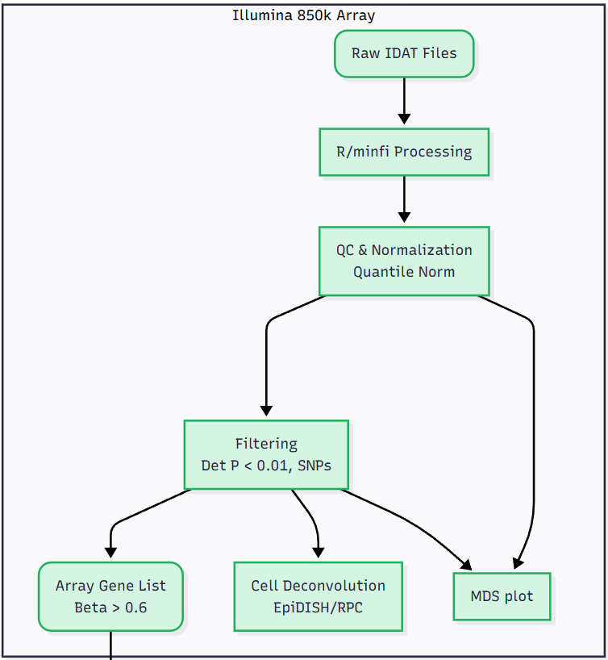
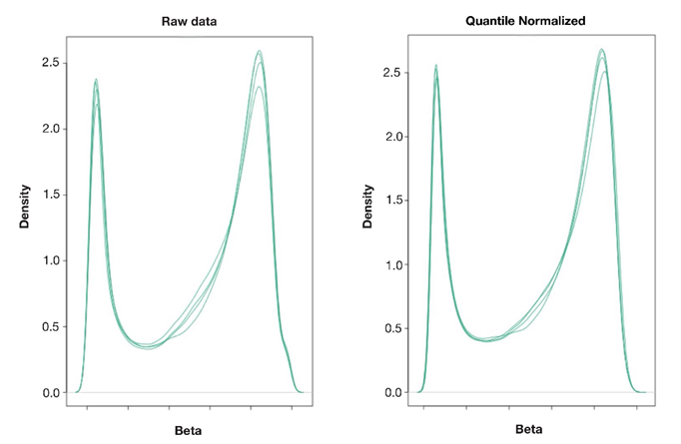
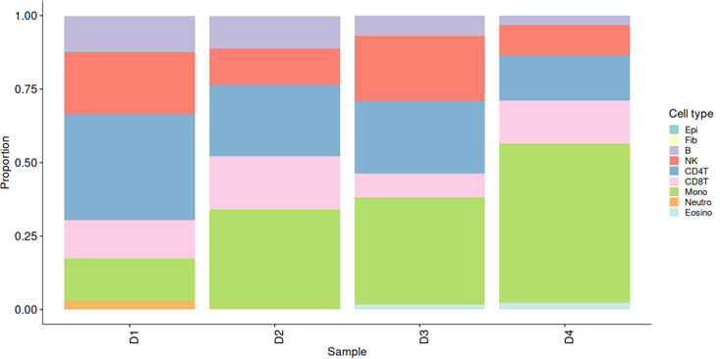
Illumina 850k Microarray Analysis
Notes:
Back to the Array - step-by-step analysis in R.
IDAT files are binary files from Illumina containing raw intensity data from microarray experiments.
At this stage I wanted to point out that the analysis is very different. We get different types of files, which require different softwares for processing and we get different outputs from them. From NGS we don’t get beta values, but enrichment scores.

Slide 10
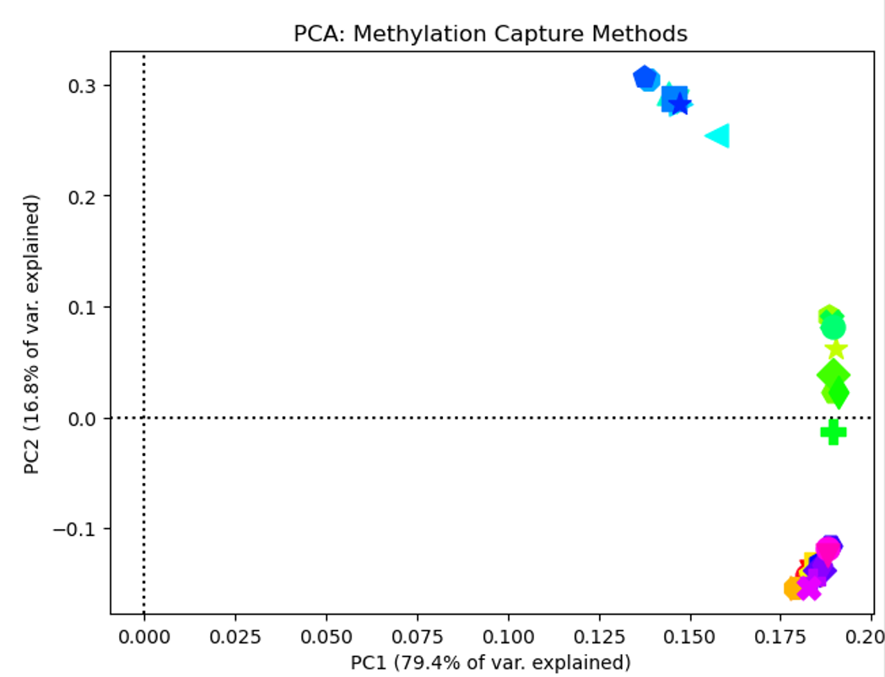
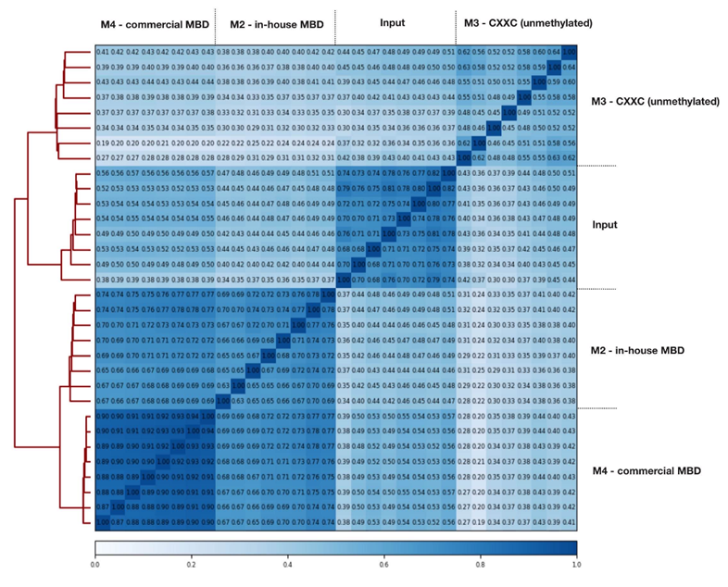
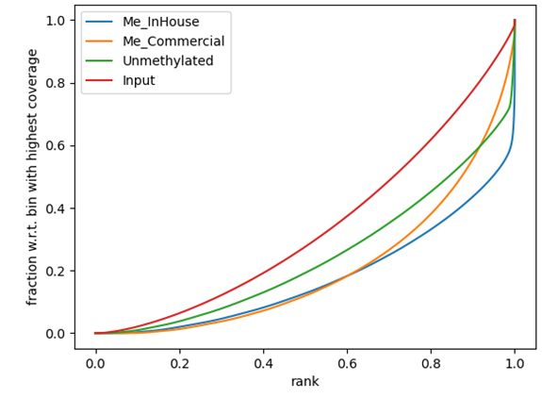
MINUTE Technical Validation
CXXC (M3)
In-house MBD (M2)
Input & Commercial MBD (M4)
PCA: Clear clustering by capture method (M2 vs M4).
Enrichment: Fingerprint plots showed significant target capture over Input background.
Correlation: Spearman coefficients confirmed high technical fidelity between replicates.
High Reproducibility!
Notes:
Back to MINUTE - go through results, each plot.
PCA: Replicates within each method clustered tightly, demonstrating high technical reproducibility, while variation along PC2 likely reflects secondary sample-specific effects. The M4 fraction (High Stringency) clusters closer to the Input, likely due to lower DNA yield in hyper-methylated regions, resulting in a higher background-to-signal ratio.
Fingerprint plot: To understand this exactly, imagine the genome is divided into millions of small "bins" or windows. The software (deepTools) ranks these bins from those with the lowest number of reads to those with the highest number of reads (x-axis).The y-axis represents a percentage scale of the cumulative fraction of total sequencing reads. As you move along the X-axis (from the lowest-ranked bin to the highest-ranked), the Y-axis adds up the number of reads found in those bins. The plot was used to determine how well the method captured its target DNA versus picking up background noise. The red Input line expected to lie very close to a perfect diagonal shows that reads are spread evenly across the genome. The green (unmethylated), yellow (commercial) and blue (in-house) lines indicate enrichment towards their targets confirming that MBD captured their targets better than the background fragments. M2 In-house (in blue) with the biggest ‘elbow bent’ shows that most methylated reads are concentrated in small genomic region which was intended for capturing.

Slide 11
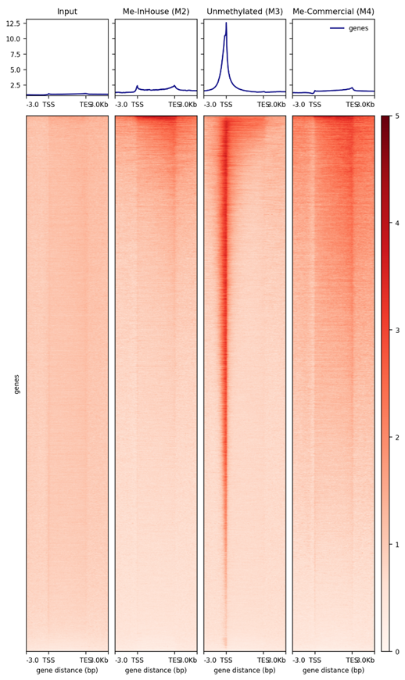
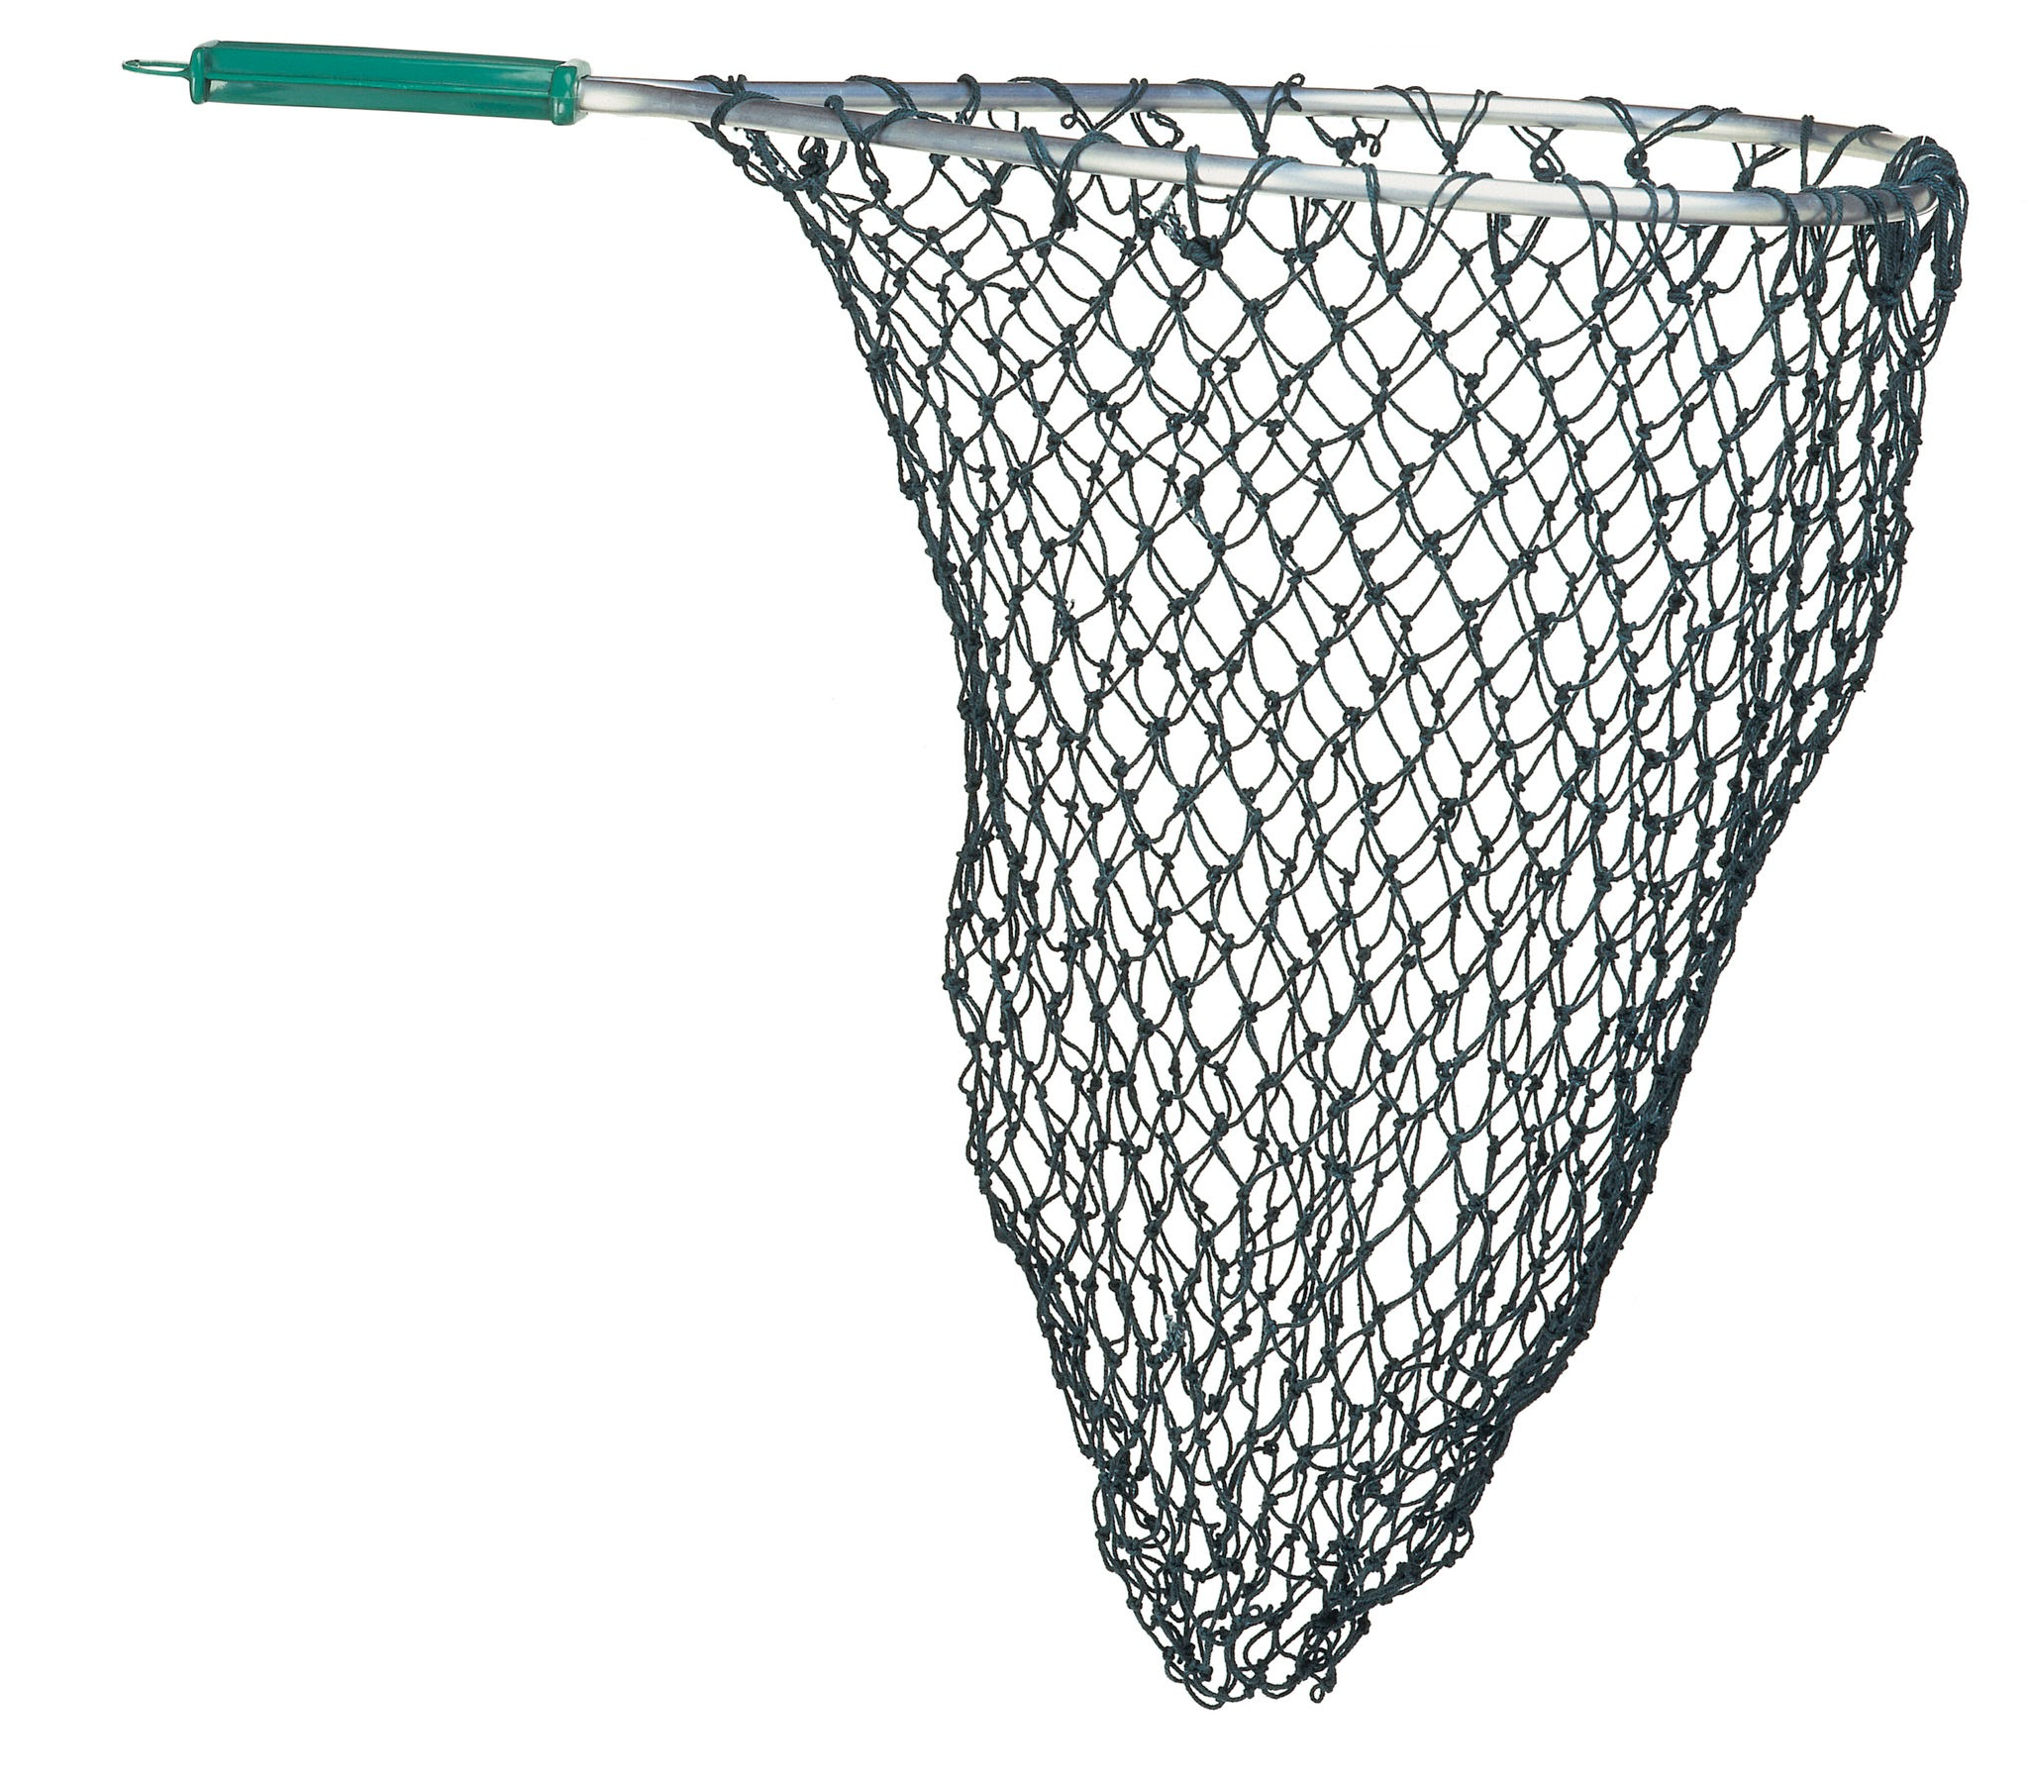
Mapping the donors
DNA
High-resolution mapping revealed characteristic landscapes at Transcription Start Sites (TSS):
Methylated (M2): Distinct "Dip" at TSS, as active genes remain unmethylated for expression.
Unmethylated (M3): Sharp "Peak" at TSS, confirming CXXC affinity for open promoters.
Notes:
In sequencing heatmaps, Red (High Intensity) always means "We found a lot of DNA here." It does not automatically mean "Methylated." It depends entirely on what "net" you used to catch the DNA.
The M2 Sample (MBD Protein)
The Net: Catches Methylated DNA.
The Signal (Red): Means "I found Methylation here."
At TSS: The TSS is usually Unmethylated. The MBD net catches nothing.
The M3 Sample (CXXC Protein)
The Net: Catches UN-methylated DNA (CpG Islands).
The Signal (Red): Means "I found UN-methylated DNA here."
At TSS: The TSS is Unmethylated. The CXXC net catches everything.
Result: Dark Red (High Signal) at the TSS.
Why: Because most genes need to be active to keep the cell alive. To be active, they must be Unmethylated.

Slide 12
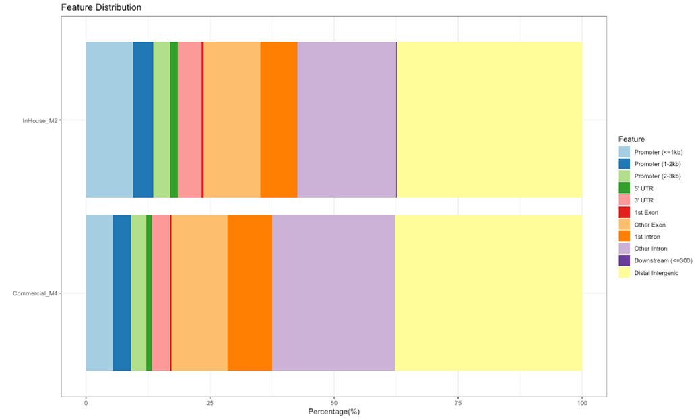
What did MBD enrich?
Core Methylated Genes
In-House MBD (M2) exhibits a higher relative concentration of peaks within the immediate promoter (≤ 1kb).
Notes:
This figure is essentially a "genomic map" of where the experimental capture worked. It answers the question: When we "fished" for methylated DNA, which parts of the gene did we actually catch?
Look at the light blue bar (Promoter $\leq$ 1kb) for InHouse_M2. It is noticeably larger than the same bar for M4. This suggests that the In-House method is more specific to the "core" promoter where transcription starts.
The Commercial_M4 sample has much larger yellow (Distal Intergenic) and purple (Other Intron) sections. This means the commercial kit captures more methylation outside of genes—this could be a good thing (discovery of new enhancers) or a bad thing (more background noise).

Slide 13
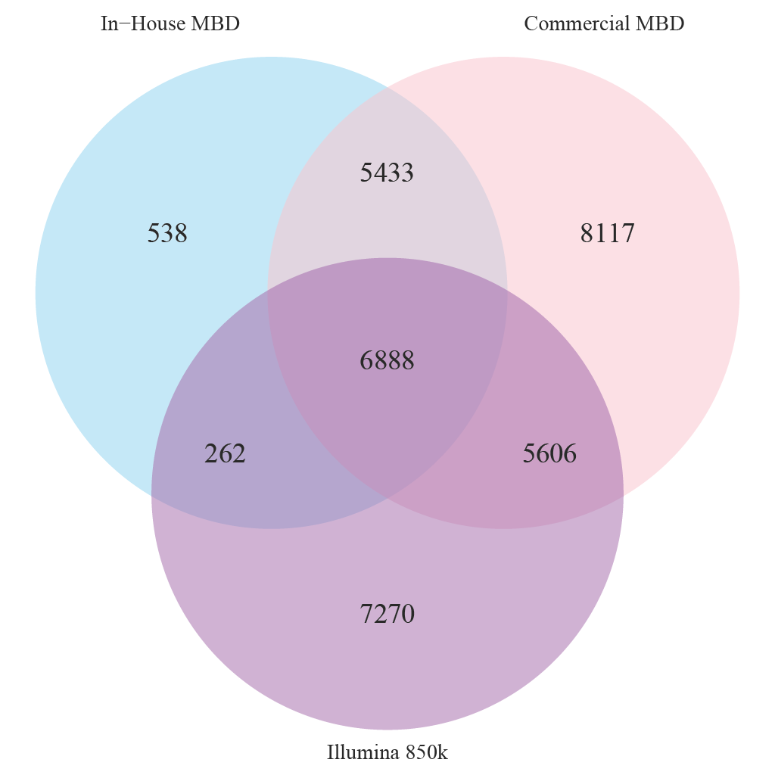
Cross-Platform Gene Overlap
Category | Total Count
In-House MBD | 13,121
Commercial MBD | 26,044
Illumina 850k | 20,026
Core Methylated Genes
6,888
Key Findings:
In-house MBD successfully captured 47% of the genes identified by commercial MBD, and 36% of the genes identified by Illumina 850k.
Commercial MBD captured 62% of genes identified by Illumina 850k.
Notes:
How was the Venn diagram created?
At first I asked myself, if we have 2 different capture methods how can we compare the results we get from them? Since they both identify genes, in one way or another, we can make lists of these genes and see how they overlap. If there is methylation signal in one sample, then both methods should come to the same conclusion. From the Array analysed data I generated a list of methylated genes (defined as beta > 0.6) and from the NGS I made a list of enriched genes. With a simple command line I overlapped the lists and derived the numbers which I then plotted on this Venn diagram.
Core (All 3 agree): 6,888 genes
These are all the methylated genes that the 3 methods found together.
First of all, by looking at the total number of genes identified, we can see clear differences as commercial MBD identified 26,044 gene names compared to only 13,121 that the in-house protein did. The in-house method captures half of the genes than a commential kit can capture, whereas the commercial kit captures 62% of the genes that Illumina array did. We could ask is that good or bad? Well, it is still different methods we’re talking about, so the signal that determines which genes are methylated is different.
Extra points:
It looks to me that the Commercial MBD has identified a very high total number of genes: 26,000. It could mean that this protein is very sensitive to methylation and will pick up anything with a methyl group attached, whereas the In-house protein from Epigenica is more specific. It could perhaps also explain why the PCA correlates with the Input, and therefore the enrichment is not highly strict, but picks up anything methylated.
It could be related to what we saw in the genomic feature distribution, where we can see that they pull more Other intron (category).
The MBD kit captures Gene Bodies and Domains, while the Array is often focused on Promoters. MBD might be calling genes "methylated" because their bodies are heavy with signal, even if the specific promoter probe on the array was unmethylated.

Slide 14
Performance Comparison
Metric | Illumina 850k Array | MINUTE-seq (NGS)
Coverage | 850,000 Fixed Probes | Genome-wide / Unbiased
Resolution | Single Nucleotide | Regional (Fragment Size)
Quantification | Absolute Beta Values | Relative Enrichment (Reads Per Million)
Discovery | Limited to Probe Set | High (Novel regions/Repeats)
Switch Detection | Measures % change at fixed locations | Detects “On-to-Off” switches anywhere in the genome

Slide 15





Future Implications & Usage
Liquid Biopsies
Scalability
Marker Discovery
Non-destructive nature allows for the analysis of limited input samples like cfDNA for cancer screening.
Cost-effective multiplexing enables large-scale longitudinal clinical studies and cohort profiling.
Unbiased genome-wide view captures silencing events in intergenic regions ignored by arrays.
Notes:
Overall, the choice of the method will always depend on the scientific question and experimental needs. If one aims to determine the methylation status of a single gene, the Illumina 850k array is superior because it uses specific, fixed probes designed to target known genomic locations at promoters and CpG islands. The results give Beta-values which can be interpreted in a binary way, if the value is >0.6 then the region is hypermethylated (switched off), while <0.2 mean hypomethylated (switched on). Whereas MINUTE-ChIP shows relative enrichment of a region, where the signal depends on read depth and the density of neighbouring CpGs. On the other hand, if the goal is to identify a change in status like silencing of tumor suppressor genes or activation of oncogenes in cancer, MINUTE-ChIP offers better potential for exploration and marker discovery. For instance, in cancer if a previously unmethylated promoter would suddenly show a strong peak (indicating methylation), it would be easier to statistically detect it than a shift in an array’s beta value.
In the future, it would be beneficial if someone tested MINUTE on a specific biological question.
From practical point of view:
Using Epigenica’s kit is very pragmatic, it looks that the method is highly reproducible and therefore reliable. It also allows for someone who has basic bioinformatics skills to follow the pipeline.
The pipeline also only takes 1 week including sample preparation, which is a relatively short time.
To my understanding, when planning experiments we typically think of number of samples beforehand and use methods that someone has validated before, so that we have an available protocol for it. I would love this work to serve as such a foundation for people to try out new approaches. Understandably, it will also come down to the cost per sample, where the more samples we analyse, the cheaper the price will be per sample, but of course more expensive in total since we need to buy more kits.

Slide 16
Summary & Conclusion
Validation: Successfully re-engineered the MINUTE-ChIP architecture for high-throughput DNA methylation analysis.
Consistency: High overlap with Illumina 850k, given that we capture a lot of off target signal.
Specificity: In-house MBD provides superior specificity for small promoter regions (≤ 1kb), less signal-to-noise ratio.
Impact: Provides a scalable, cost-effective alternative for clinical epigenetics and precision medicine.

Slide 17
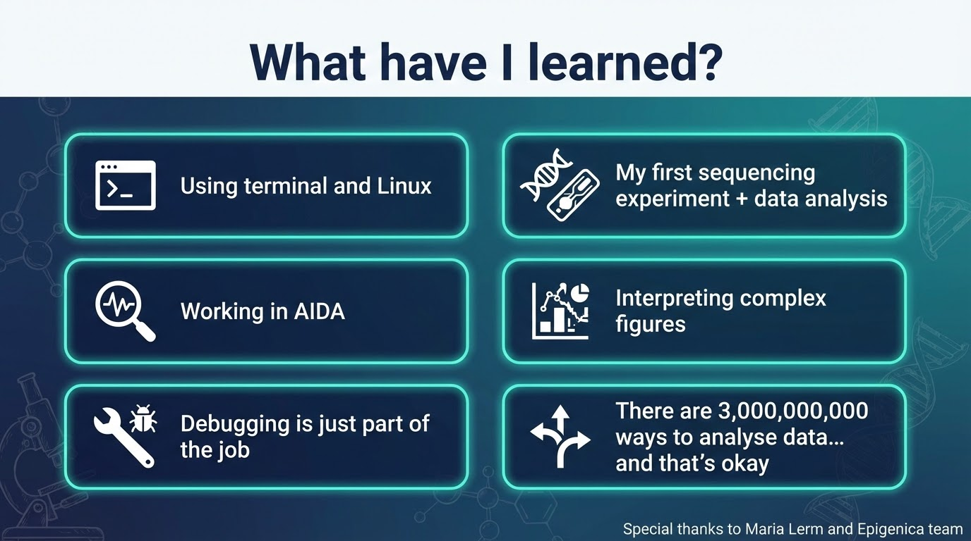

Slide 18
Acknowledgements
Shumaila - for knowing how to solve any problem
Zoe - for the resilience and commitment
Maria - for involving us all in the project
Epigenica team - Qian Li and Sara Hosseini who supported the experimental design and helped with troubleshooting

Slide 19
Thank You!
I would love to hear your feedback!
Questions & Discussion
Contact: klaudia.orfin.8677@student.uu.se

Slide 20
References
Li, L., Chen, B.-F., & Chan, W.-Y. (2015). An Epigenetic Regulator: Methyl-CpG-Binding Domain Protein 1 (MBD1). International Journal of Molecular Sciences, 16(3), 5125-5140. https://doi.org/10.3390/ijms16035125
Kumar, B., Navarro, C., Yung, P. Y. K., Lyu, J., Salazar Mantero, A., Katsori, A.-M., Schwämmle, H., Martin, M., & Elsässer, S. J. (2025). Multiplexed chromatin immunoprecipitation sequencing for quantitative study of histone modifications and chromatin factors. Nature Protocols, 20(3), 779–809. https://doi.org/10.1038/s41596-024-01058-z
https://www.researchgate.net/figure/DNA-methylation-trends-during-lineage-commitment-and-differentiation-Most-of-the-DNA_fig1_305348420
Active Motif. (2022). MethylCollector™ MBD Capture Kit Manual (Version A1). Carlsbad, CA: Active Motif, Inc. Available at: www.activemotif.com
Huoman, J., Sayyab, S., Apostolou, E., Karlsson, L., Porcile, L., Rizwan, M., … Lerm, M. (2022). Epigenetic rewiring of pathways related to odour perception in immune cells exposed to SARS-CoV-2 in vivo and in vitro. Epigenetics, 17(13), 1875–1891. https://doi.org/10.1080/15592294.2022.2089471
More detailed list in the project document

